Slide 1
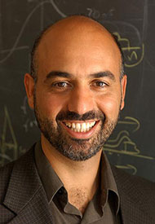
Raymond Ashoori
Notes:
# Name Raymond Ashoori # Textbook Knight, Physics for Scientists and Engineers: A Strategic Approach with Modern Physics, 3rd Edition, Chapter 38 # Description "A graduate of the University of California at San Diego (B.A. 1984) and Cornell University (Ph.D. 1991), Professor Ashoori joined the MIT faculty in 1993, after serving as a postdoctoral member of the technical staff at AT&T Bell Laboratories. He was promoted to Associate Professor in 1998 and full Professor in July 2004." # Sources http://web.mit.edu/physics/people/faculty/ashoori_raymond.html #Photo http://web.mit.edu/physics/images/faculty/ashoori_ray.jpg

